Slide 1


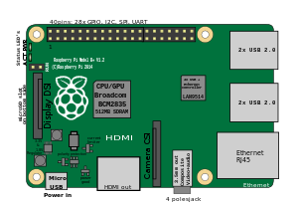

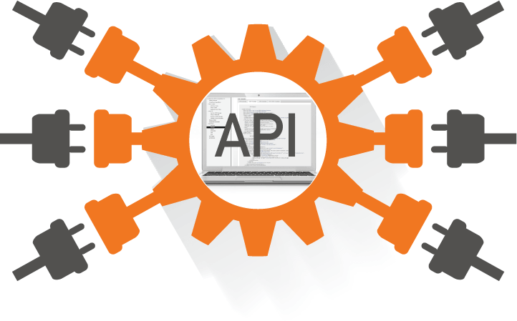
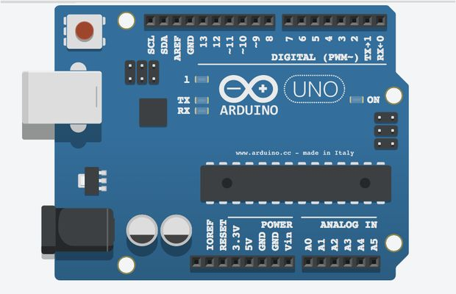

JavaScript

Slide 2

Introduction
Introduced in 1995 as a way to add programs to web in Netscape
Adopted by all major browsers
ECMA standard
Nothing to do with Java (just marketing consideration a that time)
What you know is still valid:
Comments
//…
Block of code
{ … }
Conditional execution
if, if...else, switch...case
Loops
while, do...while, for, for-in
while(number<=12) { console.log(number); number++; }
Fragment of code that produce a value is called an expression
A statement is a composition of expressions and ends with ;
Variables
Functions
We can use the browser to run JS code

Slide 3
Variables and functions
In several cases the ; can be omitted
but the rules are complex and error prone…
Dynamically-typed language
no type declaration!
let name = value; (also “var” or “const” …)
the value's type is enforced, but the variable simply represents any value of any type
let x = 'pippo'; x=5;
automatic type conversion
several time difficult to understand
console.log('5' - 1); console.log('5' + 1); console.log('5' * 2);
Functions
They are just regular variables
let name = function(parameters) { body; }
let square = function(x) { return x * x; };
can be used in any expression, and can be assigned to a new value
nested scope
can be created inside other functions
short notation
function name(parameters) { body; }

Slide 4
Equality
strict equality “===”
both the type and the value we are comparing have to be the same
5 === 5 // true
'hello world' === 'hello world' // true (both Strings, equal values)
77 === '77' // false (number vs. string)
false === 0 // false (different type and different value)
loose equality “==”
double equals also performs type coercion
values are compared after attempting to convert them into a common type!
77 == '77' // true
false == 0 // true
Triple Equals is superior to double equals!
whenever possible, you should use === to test equality
by testing type and value you can be sure that you are executing a true equality test

Slide 5
Const, let and var
var
before ES6, just var
variables assigned with the var keyword have functional scope
they aren’t block scoped
that’s where things can get messy
you can reassign variables within a block overriding parent assignments
global variables, assigned to the global window object
hoisted (can be declared after it has been used!)
let
block scoped!
not global
const
read-only and cannot’ be redeclared or reassigned
not global
not hoisted
In almost all cases, opt for const first
if assignments are read-only you avoid potential future issues
only use the let when you know that a variable will have a dynamic value
you probably don’t need to use var anymore!

Slide 6
Array
Store multiple values in a single variable
let listOfNumbers = [2, 3, 5, 7, 11, 4];
console.log(listOfNumbers[2]); //5
Properties
expressions that access a feature of some value
console.log(listOfNumbers.length); //6
two way for accessing properties [ ] and .
value.x x must be a valid property name
value[‘x’] x is evaluated to get the property name
console.log(listOfNumbers['length']);
elements in an array are stored in properties
Useful array properties
push() and pop()
add and remove elements at the end of an array
unshift() and shift()
add and remove element at the start of an array
indexOf() and lastIndexOf()
search for an element from the start of from the back
slice(start, end)
get only the part of an array between the two indexes

Slide 7
Strings
A string is a text inside double or single quotes
let carName1 = "Volvo XC60";
let carName2 = 'Volvo XC60’;
You can use quotes inside a string
as long as they don't match the quotes surrounding the string
let answer1 = "It's alright";
let answer2 = "He is called 'Johnny’”;
let answer3 = 'He is called "Johnny"';
Useful properties
length(), toUpperCase(), toLowerCase()
slice(), indexOf(), charAt()
trim(), to remove whitespaces
Compare string
let answer1 = "It's alright";
let answer2 = "It's alright";
console.log(answer1 === answer2); // true

Slide 8
Pass-by-value or pass-by-reference?
pass-by-value strategy for primitives
call-by-sharing for arrays (and objects)
similar to pass-by-reference: the function is able to modify the array content
isn’t able to assign directly over it
arrays (and objects) passed into functions are shared, but once the function decides to overwrite it, the sharing is off and the function only plays with its own version
Example:
function no_modify_primitives(x){ x = 7; }
function modify_array(array){ array[0] = 7; }
function no_modify_array(array){
array = [3, 0, 2];
array[0] = 9;
}
let x = 3;
no_modify_primitives(x);
console.log(x);
let a = [3, 0, 2];
modify_array(a);
console.log(a);
no_modify_array(a);
console.log(a);

Slide 9
Optional args and Recursion
JavaScript is extremely broad-minded about the number of arguments
if you pass too many, the extra are ignored!
if you pass too few, the missing are assigned to the undefined value
Downside: accidentally use function incorrectly
Upside: have functions taking “optional parameters”
Example:
function power(base, exponent) {
if(exponent == undefined) exponent = 2;
let result = 1;
for(let i=0; i<exponent; i++) result *= base;
return result;
}
console.log(power(3,3));
console.log(power(3));
Recursion
function power(base, exponent) {
if(exponent == undefined) exponent = 2;
if(exponent == 0) return 1;
else return base * power(base, exponent - 1);
}

Slide 10
Hands-on Activity: exercises!
Write a JavaScript program to calculate the factorial of a number
Write a JavaScript program for binary search
Write a JavaScript function to check whether a value is an integer or not
Write a JavaScript function to calculate the sum of values in an array
Write a JavaScript program to sort a list of elements using Bubble sort
Write a JavaScript program to sort a list of elements using Quick sort
Code: solutions1.docx

Slide 11
High-order functions
Functions that operate on other functions
taking them as arguments, or returning theme
Allow to abstract over actions, not just values
Example:
function greater_than(n) {
return function(m) { return n>m; };
}
let greater_than_10 = greater_than(10);
console.log(greater_than_10(7)); //true
console.log(greater_than_10(11)); //false
let greater_than_4 = greater_than(4);
console.log(greater_than_4(3)); //true
console.log(greater_than_4(5)); //false
n is a parameter of the outer function, but because the inner function lives inside the environment of the outer one, it can use n
the body of the inner function can access variables around it
Other examples: filter, map, reduce
Code: 01.Javascript-example

Slide 12
Filter, map, reduce
function filter(array, test) {
let passed = [];
for(let i=0; i<array.length; i++)
if(test(array[i])) passed.push(array[i]);
return passed;
}
let a=[2,3,5,6];
let test = function(x) { return x>=5; }
let filtered = filter(a, test)
console.log(filtered);
function map(array, transform) {
let mapped = [];
for(let i=0; i<array.length; i++) mapped.push(transform(array[i]));
return mapped;
}
let a = ['3', '5', '6'];
console.log(a);
let transform = function(x) { return Number(x) }
let mapped = map(a, transform);
console.log(mapped);
function reduce(array, combine, start) {
let current = start;
for(let i=0; i<array.length; i++) current = combine(current, array[i]);
return current;
}
let a = [3, 5, 6];
let sum = function(x,y) { return x+y; };
let result = reduce(a, sum, 0);
console.log(result);

Slide 13
Objects
Arbitrary collections of properties
you can create object directly, without a class!
let name = { list of properties separated by commas };
Properties are specified by a name, a colon, and an expression
let example = { name: 'example', values : [1,2,3], length: 3 }
console.log(example);
Not compare objects with == (e.g. remember pointers...)
let example1 = { name: 'example' }
let example2 = { name: 'example' }
console.log(example1 == example2); //false
Methods
properties that hold function values
“this” (in the body of the function) points to the object
let example = {name: 'example', append: function(x){this.name = this.name + ' ' + x;} }
console.log(example);
example.append('pippo’);
console.log(example);
The Math object: a container to group a bunch of math related functionalities
The JSON object: stringify(), parse() to convert data from end to this format
Code: 01.Javascript-example.js

Slide 14
Object-Oriented concepts
Factory
to create more than just a single object
like classes in OOP languages
it is simply a function called with the new keyword
function Person(first, last, age) {
this.firstName = first;
this.lastName = last;
this.age = age;
}
let myFather = new Person("John", "Doe", 50);
Prototypes
to add new properties (or methods) to all existing objects of a given type
Person.prototype.nationality = "English";
Person.prototype.name = function() {return this.firstName + " " + this.lastName;};
Getters and Setters
specify properties that look like normal properties but secretly have set/get
function Container(val){
let secret = val;
this.__defineGetter__("secret", function(){ return secret; });
this.__defineSetter__("secret", function(val){ secret = val; });
}
let test = new Container(35);

Slide 15
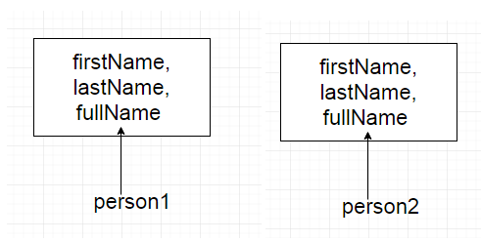
Factory vs Prototypes
Problem with factory
every object has its own instance of functions
wastage of memory
function Person(firstName, lastName) {
this.firstName = firstName,
this.lastName = lastName,
this.fullName = function() { return this.firstName + " " + this.lastName; }
}
let person1 = new Person("Paolo", "Rossi");
let person2 = new Person("Giovanni", "Bianchi");
Problem with the prototype
modifying a property using one object reflects the other object also
function Person(){ }
Person.prototype.name = "Riccardo" ;
Person.prototype.friends = ['Paolo', 'Giovanni’]
let person1 = new Person();
let person2 = new Person();
person1.friends.push("Francesco");
console.log(person1.friends); // Output: "Paolo, Giovanni, Francesco"
console.log(person2.friends); // Output: "Paolo, Giovanni, Francesco"
Define object specific properties inside the factory and shared properties and methods inside the prototype!

Slide 16
Classes
ES6 introduced classes
Like a factory, but it use the keyword class
properties are assigned inside a constructor() method
it is called automatically when a class is initiated
we can make our own methods
we can create “static” methods
cannot be called on the object, but on the class
class Car {
constructor(brand) { this.carname = brand; }
present() { return "I have a " + this.carname; }
static hello() { return "Hello!!"; }
}
mycar = new Car("Ford"); mycar.present(); mycar.hello() //ERROR Car.hello();
We have inheritance, using the “extends” keyword class Model extends Car { constructor(brand, mod) { super(brand); this.model = mod; } show() { return this.present() + ', it is a ' + this.model; }}

Slide 17
Classes
Classes also allows us to use getters and setters
use the get and set keywords
names of getter/setter method cannot be the same as the name of the property (many use the _ before property name)
class Car {
constructor(brand) { this._carname = brand; }
get carname() { return this._carname; }
set carname(x) { this._carname = x; }
}

Slide 18
Polymorphism
When a piece of code is written to work with objects that have a certain interface any kind of object that happens to support this interface can be plugged into the code, and it will just work
Polymorphism without inheritance!
function Person(age) {
this.age = age;
this.getInfo = function() { return "I am " + this.age + " years old "; };
}
function Employee(age, salary){
this.salary = salary;
this.age = age;
this.getInfo = function() {
return "I am " + this.age + " years old and earns " + this.salary;
};
}
// The method getInfo() to be executed depend on the object that 'obj' refer to
function showInfo(obj) { console.log(obj.getInfo()); }
let person = new Person(50);
let employee = new Employee(43, 50000);
showInfo(person);
showInfo(employee);

Slide 19
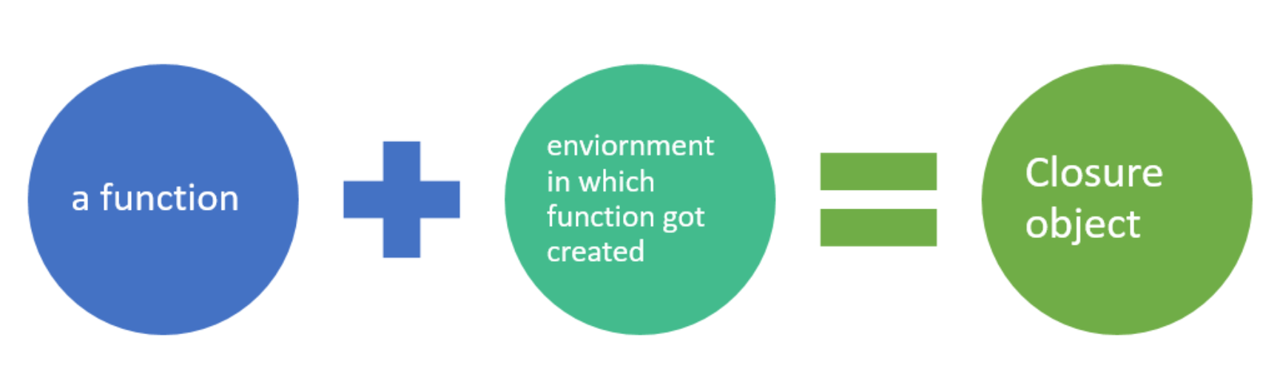
Closures
What happens to variables when the function that create them is no longer active?
function wrapValue(n) {
let localVariable = n;
return function() { return localVariable; };
}
let wrap1 = wrapValue(1);
let wrap2 = wrapValue(2);
console.log(wrap1());
console.log(wrap2());
The feature of being able to reference an instance of a local variable also when it is called outside its scope
it’s a very powerful and modern programming style (functional)
Think of it as an handle to a piece of computation, frozen for later use
function multiplier(factor) {
return function(number) { return number * factor; };
}
let twice = multiplier(2);
console.log(twice(5));

Slide 20
Lambda and Arrow Functions
Expressions that create functions
really important for programming languages that support first-class functions
In JavaScript pre-ES6 we have only anonymous functions
functions without a name)
let anon = function (a, b) { return a + b };
ES6 introduces lambda (or arrow) functions with a more flexible syntax
let anon = (a, b) => a + b;
let anon = (a, b) => { return a + b };
[1,2,3,4].filter(function (value) {return value % 2 === 0});
[1,2,3,4].filter(value => value % 2 === 0);
In general:
if there are 0 parameters, arrow functions use empty parenthesis
() => { statements }
if there is 1 parameter, arrow functions can omit the parenthesis
parameter => { statements }
if there are 2+ parameters, parameters go inside parenthesis
(param1, param2, ...) => { statements }

Slide 21
Programming Paradigms
Procedural Programming
based upon the concept of the procedure call
simply contain a series of computational steps to be carried out
C language
Object Oriented Programming
based on the concept of objects
contains data (attributes) and procedures (methods)
C++, Java, C# languages
Functional Programming
treats computation as the evaluation of mathematical functions
avoiding changing-state and mutable data
it emphasizes the application of functions, in contrast to the changes in state
Scala, F#, JS

Slide 22
Imperative vs Declarative Patterns
Imperative Pattern
focuses on describing how a program operates
consists of commands for the computer to perform
Declarative Pattern
focuses on what the program should accomplish
without specifying how the program should achieve the result
let books = [
{ name:'JavaScript', pages:450 },
{ name:'Angular', pages:902 },
{ name:'Node', pages:732 }
];
// Imperative Pattern
for (let i = 0; i < books.length; i++) {
books[i].lastRead = new Date();
}
// Declarative Pattern
books.map((book) => {
book.lastRead = new Date();
return book;
});
Functional programming follows declarative pattern

Slide 23
Javascript: more...
Complete example: linked list
Code: 02.LinkedList.js
Exception handling
Regular Expressions
Modules
Talking with the Browser
HTML tag <script>
DOM (Document Object Model)
Handling events (we introduce it with NodeJS)
EventListener, events (keydown, keyup, click, mousedown, etc.)
Timers
Forms
...

Slide 24
Hands-on Activity: exercises!
Write a JavaScript program to list the properties of a JavaScript object
Write a JavaScript program to and a property and delete another property from an object. Print the object before or after deleting the property.
Write a JavaScript program to display the reading status (i.e. display book name, author name and reading status) of a set of books.
Write a JavaScript program to get the volume of a Cylinder with four decimal places using object classes
Write a JavaScript program to calculate the area and perimeter of a circle. Create two methods to calculate the area and perimeter. The radius of the circle will be supplied by the user
Code: solutions2.docx

